Slide 1
Model-View-Controller (MVC)
Module 14

Slide 2
What is the separation of concerns principle?

Slide 3
Separation of concerns is a design principle that each section of a program should address a separate concern.

Slide 4




Separation of Concerns
In a restaurant:
Chef
Server
Customer
The chef’s concern is to cook the food.
The server’s concern is to take orders and serve food.
A customer’s concern is to order and eat.
We do not expect the customer to go back into the kitchen to cook food or the server to sit at a table and order, etc.
Notes:
Shutterstock_785814265
Shutterstock_1392204758
shutterstock_125612237

Slide 5
What is MVC?

Slide 6
The Model-View-Controller (MVC) framework is an architectural pattern that adheres to the separation of concerns principle.

Slide 7
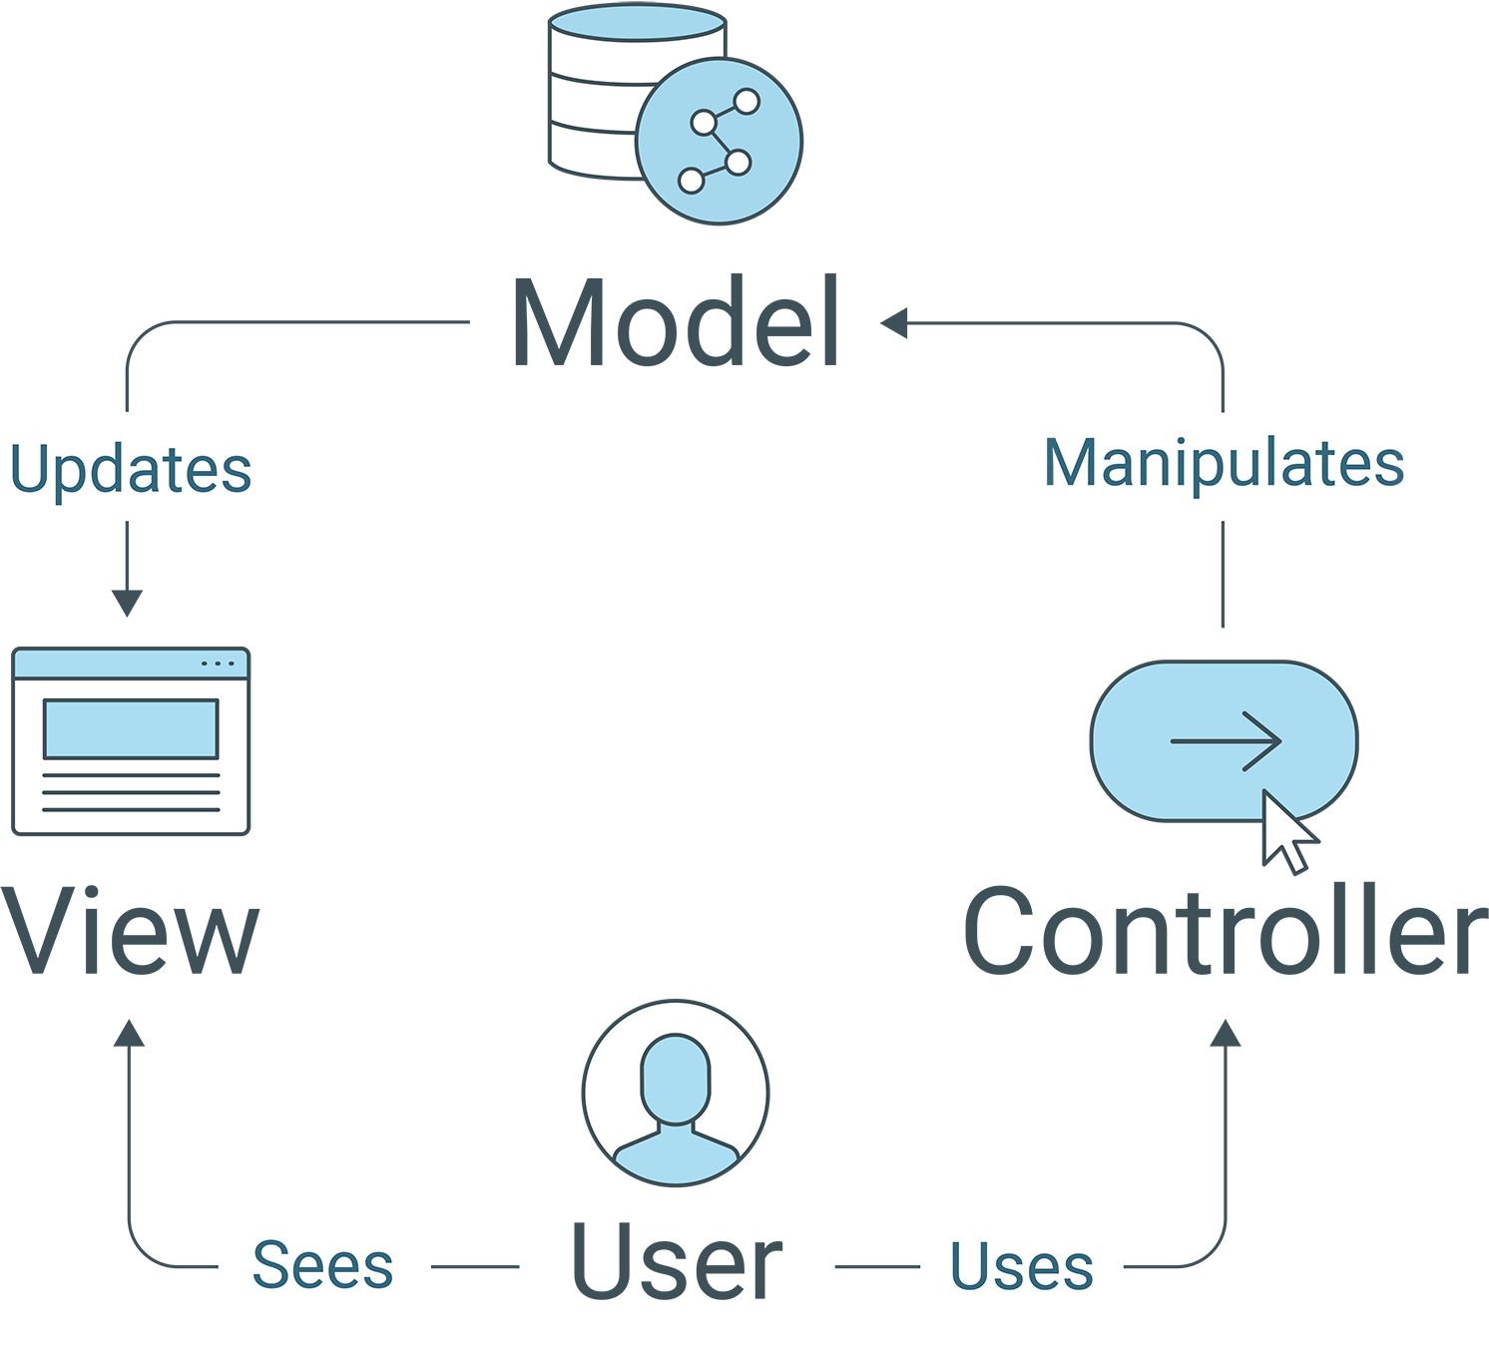
MVC Framework
The Model stores data and data-related logic.

Slide 8
MVC Framework
The View is in charge of UI/UX concerns, or what a user will see and interact with.

Slide 9
MVC Framework
The Controller is the interface between Models and Views. It processes requests from the View, uses the Model to manipulate data, and sends data to the View to render.

Slide 10
What is a template engine?

Slide 11
A template engine is software that allows us to combine data with a static template to generate dynamic HTML.

Slide 12
Template Engines
Most template engines offer the following features:
Placeholders for data that we wish to include
Functions
Conditional rendering and looping
Text replacement

Slide 13
What are the advantages of using template engines?

Slide 14
Template Engines
Template engines provide the following benefits:
They help us follow the separation of concerns principle and MVC by providing an easy, clean way to separate HTML and JavaScript.
They offer tools that reduce repetition in code.
Templates are easy to create, use, and maintain.
They improve SEO and make fewer client-to-server requests.

Slide 15
What is Handlebars.js?

Slide 16
Handlebars.js is an extension of the templating language Mustache.

Slide 17
{{Handlebars.js}}
It is a logicless templating language that separates code from the View.
It compiles templates into a single resource and then returns the HTML after replacing variables with data.
It is a pure rendering engine—meaning that it has no built-in support for event handling, accessing back-end services, or making incremental DOM updates.

Slide 18
Why are we learning Handlebars.js?

Slide 19
Why Handlebars.js?
Handlebars.js provides the following benefits:
It gives us a great introduction to template engines because it is easy to use but offers a ton of functionality. It isn’t the only option out there, but it is a great place to start!
It prepares us to encounter other languages that have this sort of templating built into them.
It helps us follow separation of concerns and the MVC framework.
It is a step towards learning to use heavier frameworks like React.js to build single-page applications.

Slide 20
How can we learn to implement MVC and Handlebars.js?

Slide 21
Handlebars.js and other template engines are designed to make implementing the MVC pattern easier.

Slide 22
How to learn MVC and Handlebars.js
You can try the following strategies to learn MVC and Handlebars.js:
Read the official documentation and practice with the provided examples.
Reverse-engineer finished code to see how something was accomplished.
Build something from scratch.
Debug a broken app.
And most importantly, ask questions!

Slide 23
Mini-Project

